Slide 1



UNH SEDS
CEPS Engineering Organization
High Power Rocketry
University of New Hampshire
Students for the Exploration and Development of Space

Slide 2

University of New Hampshire
Students for the Exploration and Development of Space

Slide 3

University of New Hampshire
Students for the Exploration and Development of Space

Slide 4
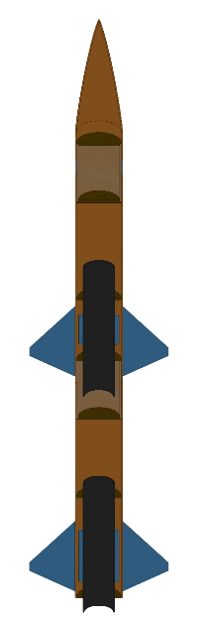


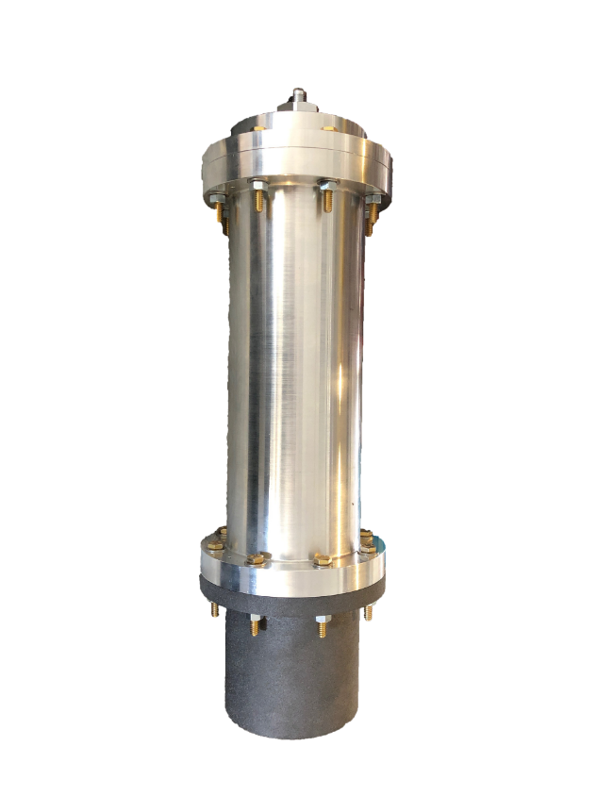
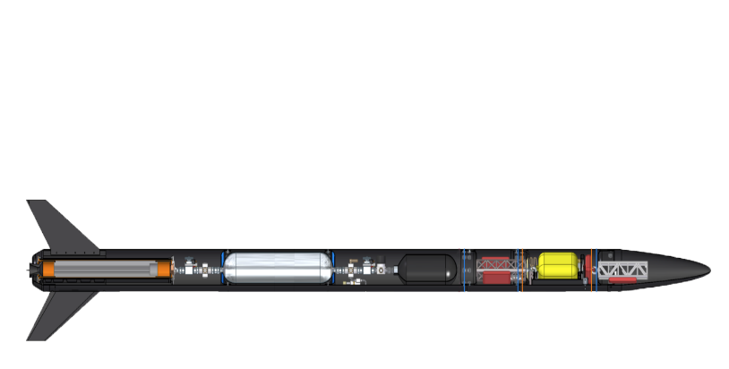

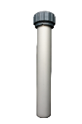

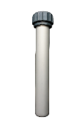
The Three Year Plan
Year One
2017-2018
Hybrid Engine
Design
Manufacture
Test
Year Three
Runaway
Rocket Building
Simulating
Launching
Optimizing
Hybrid Rocket
Engine Optimization
Rocket Integration
Competition
Year Two
University of New Hampshire
Students for the Exploration and Development of Space

Slide 5

University of New Hampshire
Students for the Exploration and Development of Space

Slide 6
Project Overview
Design and test a hybrid rocket for Spaceport America Cup
Propulsion
Frame
Avionics/Payload/Recovery
Operations
Research thrust vector control on COTS engines
Feedback and Control
Mechanical Design
University of New Hampshire
Students for the Exploration and Development of Space

Slide 7
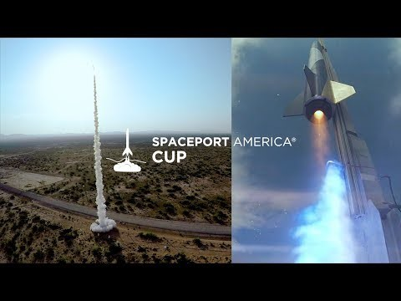
University of New Hampshire
Students for the Exploration and Development of Space

Slide 8
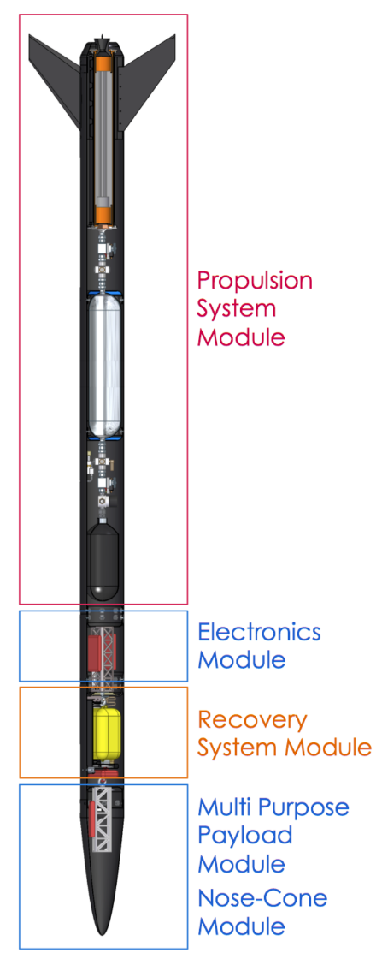
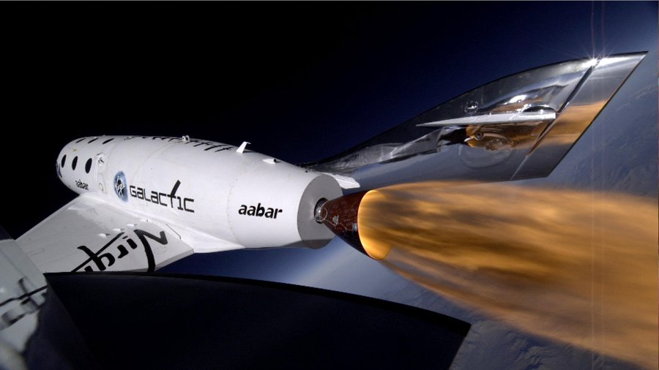
What is a Hybrid Engine Rocket?
Rocket is propelled via solid and liquid components
HTPB Rubber and Nitrous Oxide
Virgin Galactic’s SpaceShipTwo!
University of New Hampshire
Students for the Exploration and Development of Space

Slide 9
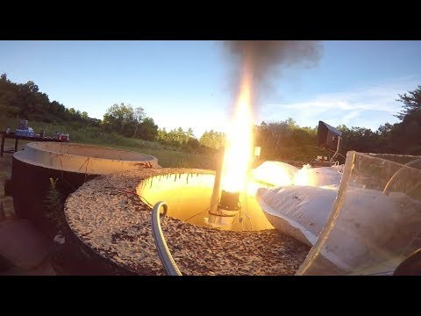
Propulsion Team
University of New Hampshire
Students for the Exploration and Development of Space

Slide 10
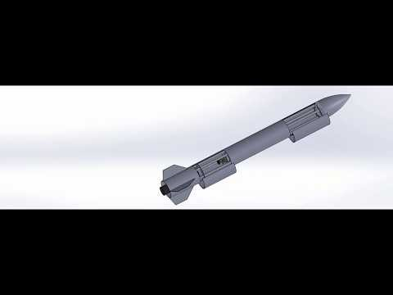
Frame Team
University of New Hampshire
Students for the Exploration and Development of Space

Slide 11
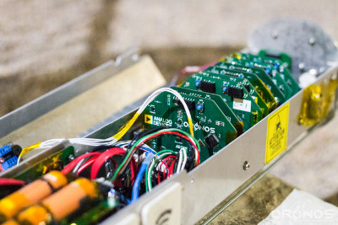
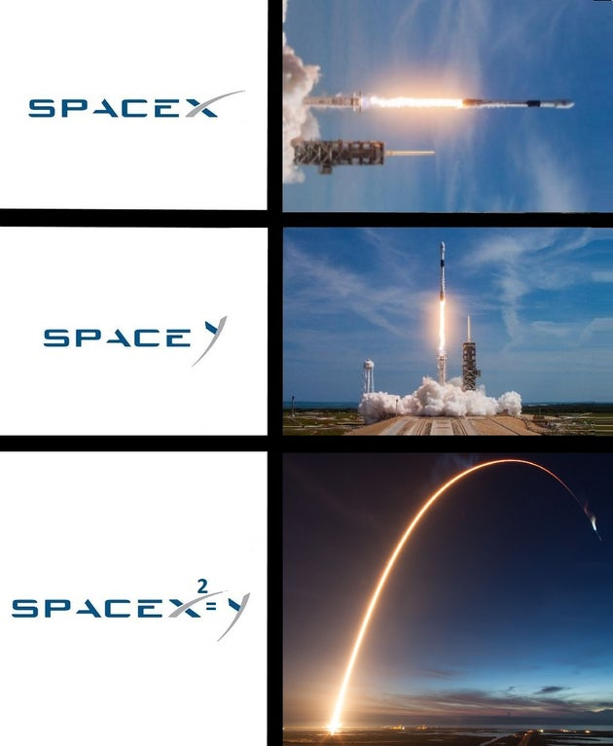
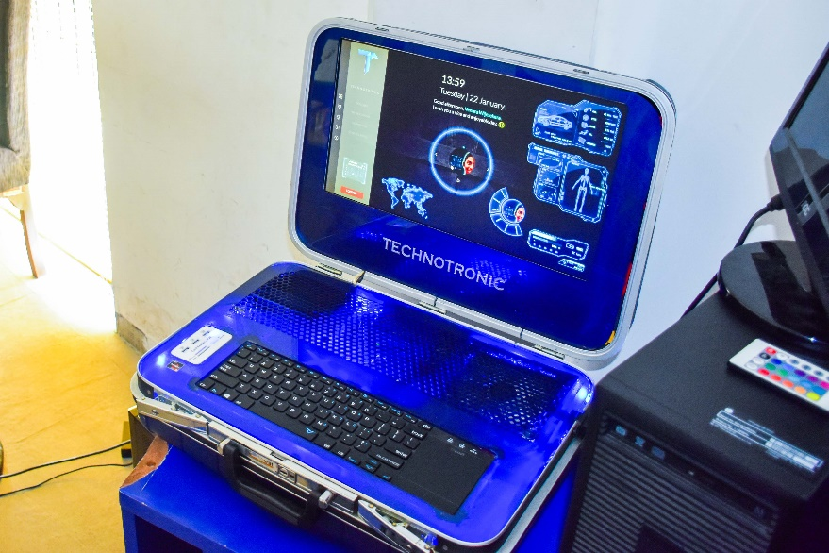
Avionics/Payload/Recovery Team
Electrical system of Rocket
Launch Control Module
Live data communication
GPS tracking
University of New Hampshire
Students for the Exploration and Development of Space

Slide 12
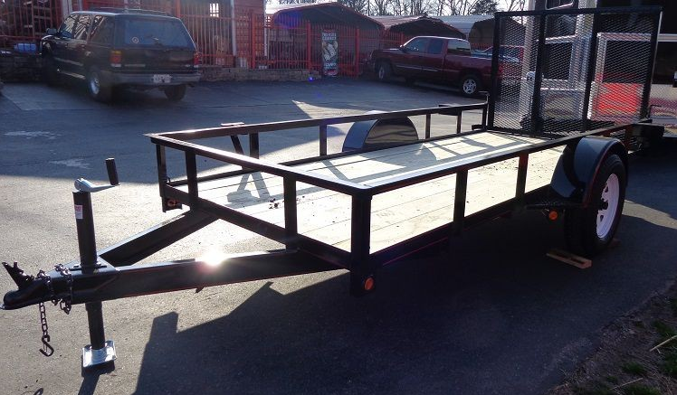
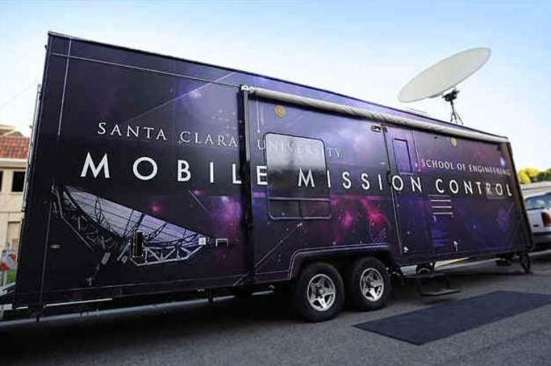
Operations Team
In charge of all Spaceport coordination and requirements
Engineering integration and systems engineering
Responsible for coordinating tests
Safety
Aid in all engineering-related activities
University of New Hampshire
Students for the Exploration and Development of Space

Slide 13
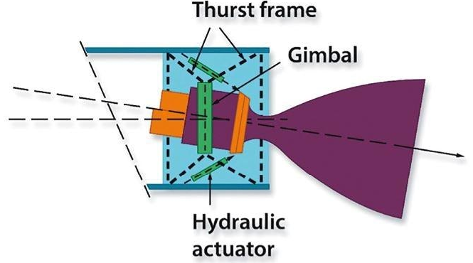
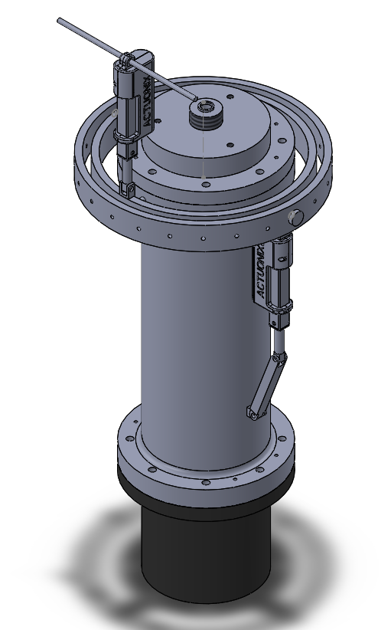
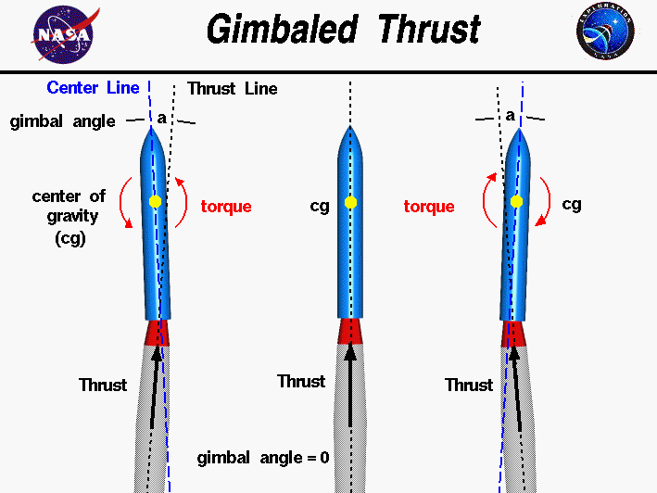
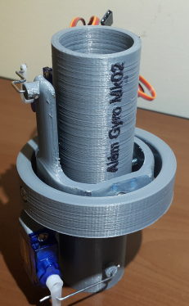
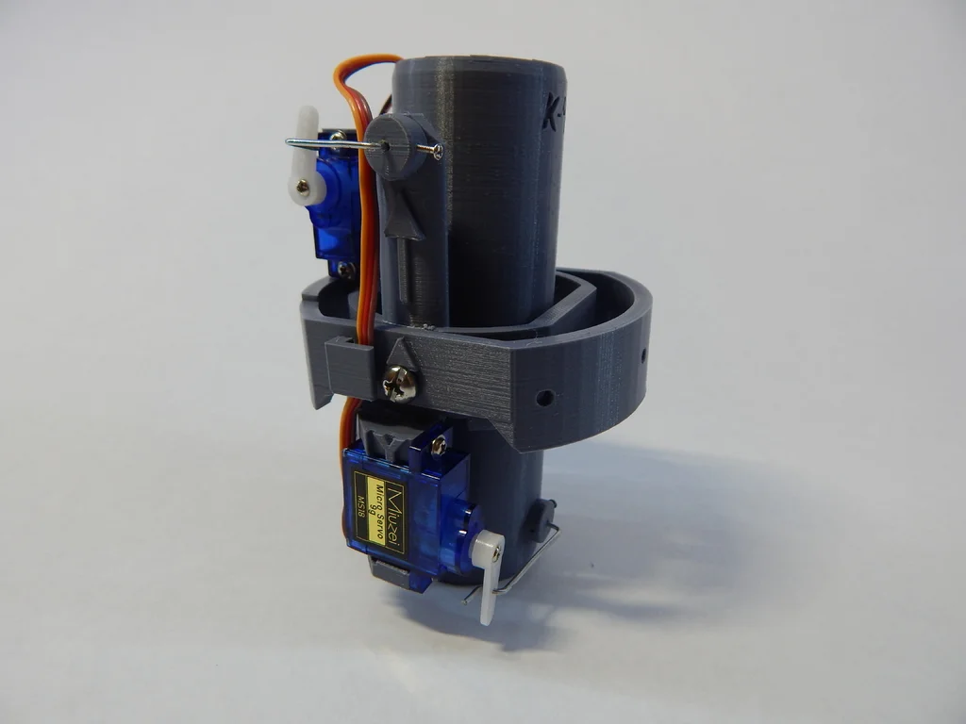
Gimbal System
Control the direction of thrust and the orientation of the rocket
First step towards following predefined flight trajectories
Project Tasks:
Measuring system parameters
Numerical modeling
Gimbal hardware design
Control algorithm design
Static testing of stability
Flight implementation and testing
(PS: If you are interested in quadcopters, talk to me after!)
University of New Hampshire
Students for the Exploration and Development of Space

Slide 14
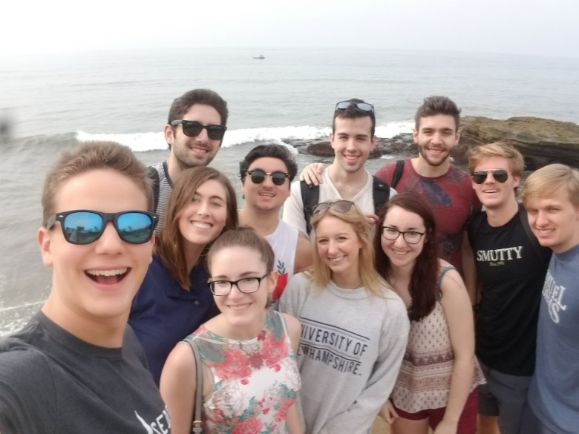
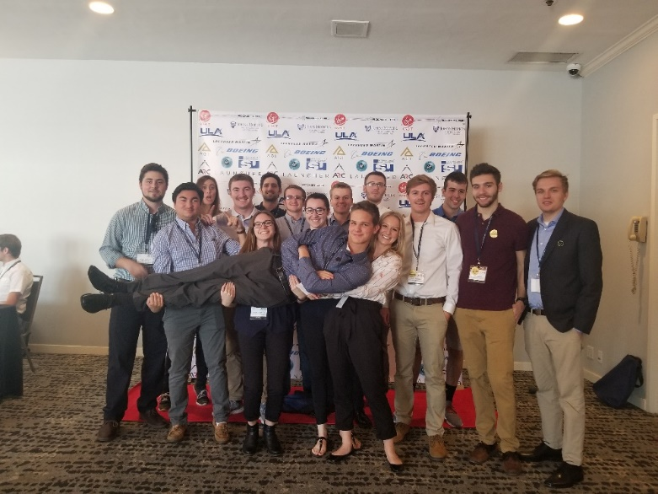
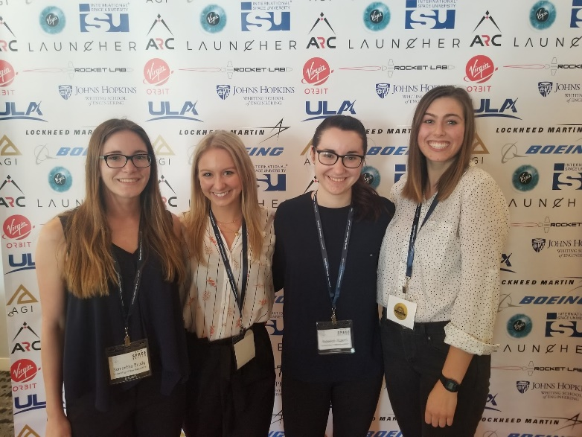
SpaceVision
SEDS USA hosts a national conference every year called ‘SpaceVision’ where many of the various SEDS chapters congregate to network and listen to speakers. This year, it will be on November 2019 in Arizona State University. We brought 16 of our members to take part in the 2018 SpaceVision located in San Diego California.
University of New Hampshire
Students for the Exploration and Development of Space
Notes:
EE major too

Slide 15







Networking Opportunities
University of New Hampshire
Students for the Exploration and Development of Space
Notes:
EE major too

Slide 16

Recruitment Program – Monday’s at 8:00 pm in Kings S172
Information Night
Tonight!
Meet The Team
Who is UNH SEDS? Who are you?
Rocket Building Techniques Workshop
How do you build a rocket from scratch? Make sure it works on the pad? We got you.
Team Selection/Mentor Pairing
Let’s get you up to speed on the projects that interest you… and get a friend!
Week 1
9/11
Week 2
9/16
Week 3
9/23
Week 4
9/30
University of New Hampshire
Students for the Exploration and Development of Space
Notes:
EE major too

Slide 17



UNH SEDS
Plz follow us
University of New Hampshire
Students for the Exploration and Development of Space
Notes:
EE major too

Slide 18
University of New Hampshire
Students for the Exploration and Development of Space
Notes:
EE major too

